Slide 1
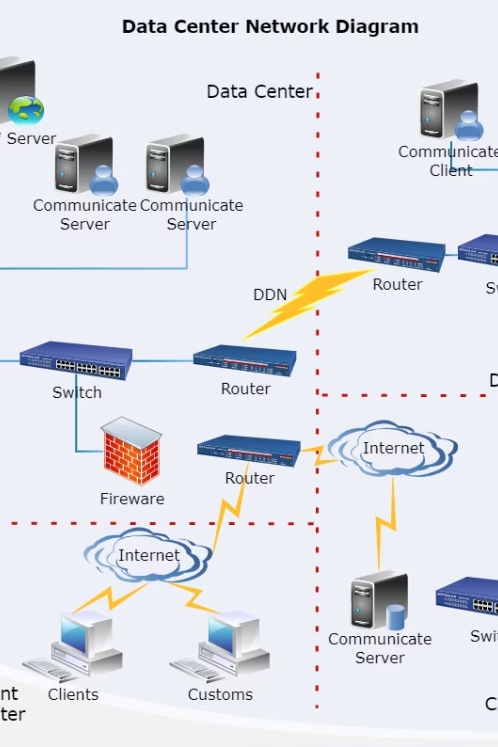
Windows Security Policy
A comprehensive guide to implementing and managing security policies in enterprise Windows environments. This presentation covers essential security configuration tools, Group Policy management, administrative controls, and network hardening techniques used by IT professionals worldwide.

Slide 2
Building Secure Windows Environments
This comprehensive training session covers the critical components of Windows security infrastructure that every system administrator and IT security professional must master. We'll explore both theoretical concepts and hands-on practical implementations that you can apply immediately in production environments.
01
02
Security Templates & Configuration Analysis
Group Policy Architecture
Learn to create, apply, and analyze security templates using built-in Windows tools. We'll work with the Security Configuration and Analysis snap-in to establish security baselines.
Master both Local and Domain Group Policy Objects, understanding their hierarchy, precedence, and proper implementation strategies for enterprise environments.
03
04
Access Control & Application Security
Policy Hardening & Network Security
Configure administrative user controls, implement AppLocker policies, and properly deploy User Account Control to minimize privilege escalation risks.
Review and implement recommended GPO settings including password policies, account lockout configurations, security options, and network hardening techniques.

Slide 3
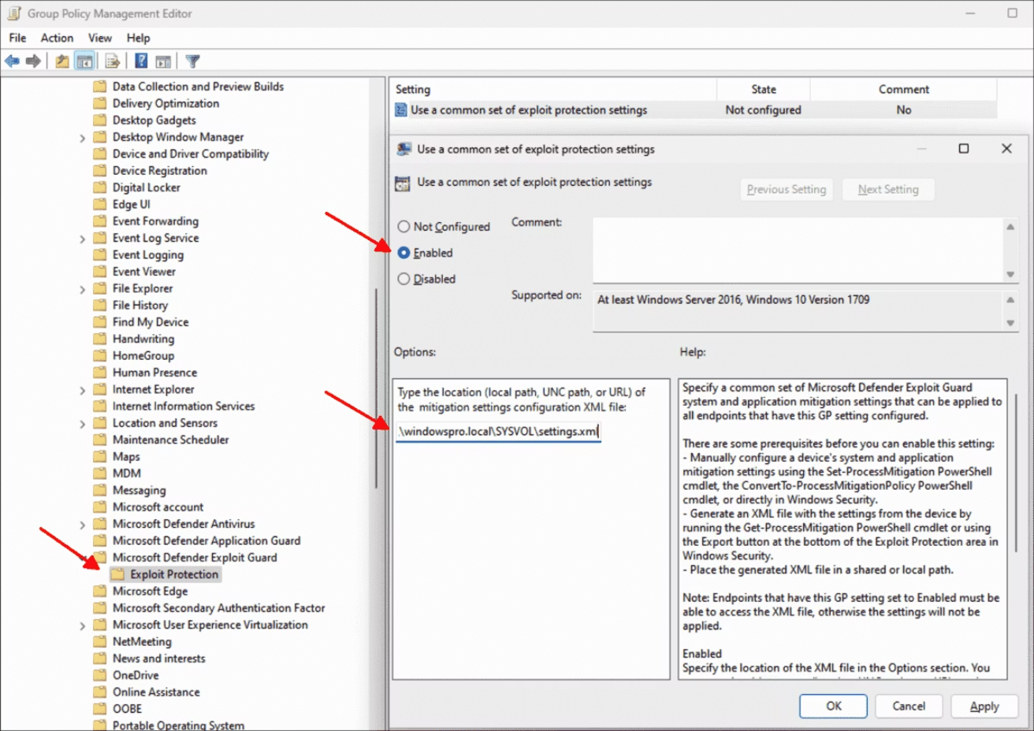

Understanding Security Templates in Windows
Security templates are text-based configuration files (.inf format) that define security settings for Windows systems. They provide a standardized way to configure and deploy security policies across multiple computers, ensuring consistency and compliance with organizational security standards.
Key Components of Security Templates:
Account Policies: Password policy, account lockout policy, and Kerberos policy settings that govern authentication mechanisms
Local Policies: Audit policy, user rights assignment, and security options that control system behavior and access
Event Log Settings: Configuration for Application, Security, and System event logs including size and retention policies
Restricted Groups: Membership control for sensitive security groups like Administrators and Backup Operators
Pro Tip: Always test security templates in a non-production environment first. Incorrect configurations can lock out administrators or disrupt critical services.
System Services: Startup configuration and permissions for Windows services
Registry Permissions: Access control lists for critical registry keys
File System Permissions: NTFS permissions for folders and files
Templates are stored in %SystemRoot%\Security\Templates by default and can be created, modified, or imported using various administrative tools.

Slide 4




Working with Pre-Built Security Templates
Windows Server includes several pre-configured security templates designed for different security levels and scenarios. Understanding these templates is essential before creating custom configurations.
Setup security.inf
The default security configuration applied during Windows installation. This template represents the baseline security posture and is useful for rollback scenarios.
Securedc.inf & Securews.inf
Enhanced security templates for domain controllers and workstations respectively. These templates increase password complexity requirements, strengthen audit policies, and restrict anonymous access to system resources.
Compatws.inf
Reduces security settings to allow legacy applications to run. This template relaxes file system and registry permissions for the Users group, enabling older software that requires elevated privileges to function.
Hisecdc.inf & Hisecws.inf
Maximum security templates that enforce strong encryption, disable unnecessary services, and implement strict access controls. Use these in high-security environments where compatibility with older systems is not a concern.
Important Consideration: The Compatws.inf template should only be used temporarily during application migration or testing, never as a permanent security posture.

Slide 5
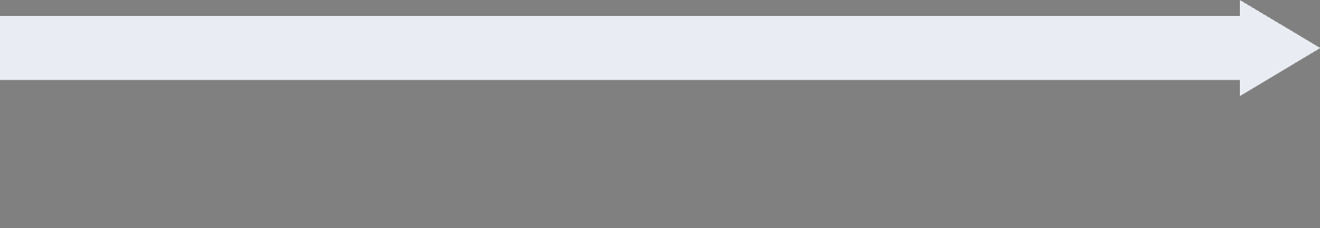
Security Configuration and Analysis Snap-in: Step-by-Step Guide
The Security Configuration and Analysis (SCA) snap-in is a powerful tool that allows administrators to analyze current security settings against a baseline template and apply configurations. This tool is essential for security auditing and compliance verification.
Create Security Database
Launch the Tool
Step 4: Right-click Security Configuration and Analysis in the console tree and select Open Database.
Step 1: Press Win + R, type mmc, and press Enter to open an empty Microsoft Management Console.
Step 5: Enter a name for your new database (e.g., "SecurityAudit.sdb") and click Open.
Step 2: Click File > Add/Remove Snap-in (or press Ctrl+M).
Step 6: Select a security template to import (browse to %SystemRoot%\Security\Templates), then click Open.
Step 3: Select Security Configuration and Analysis from the available snap-ins list, click Add, then OK.
Apply Security Configuration
Analyze Current Configuration
Step 10: After reviewing discrepancies, right-click Security Configuration and Analysis and select Configure Computer Now.
Step 7: Right-click Security Configuration and Analysis and select Analyze Computer Now.
Step 11: Confirm the log file path and click OK to apply the security template settings to your system.
Step 8: Accept the default log file path or specify a custom location, then click OK.
Step 9: Review the analysis results. Items marked with a red X indicate discrepancies between the current configuration and the template.
Step 12: Review the configuration log for any errors or warnings that may require manual intervention.

Slide 6
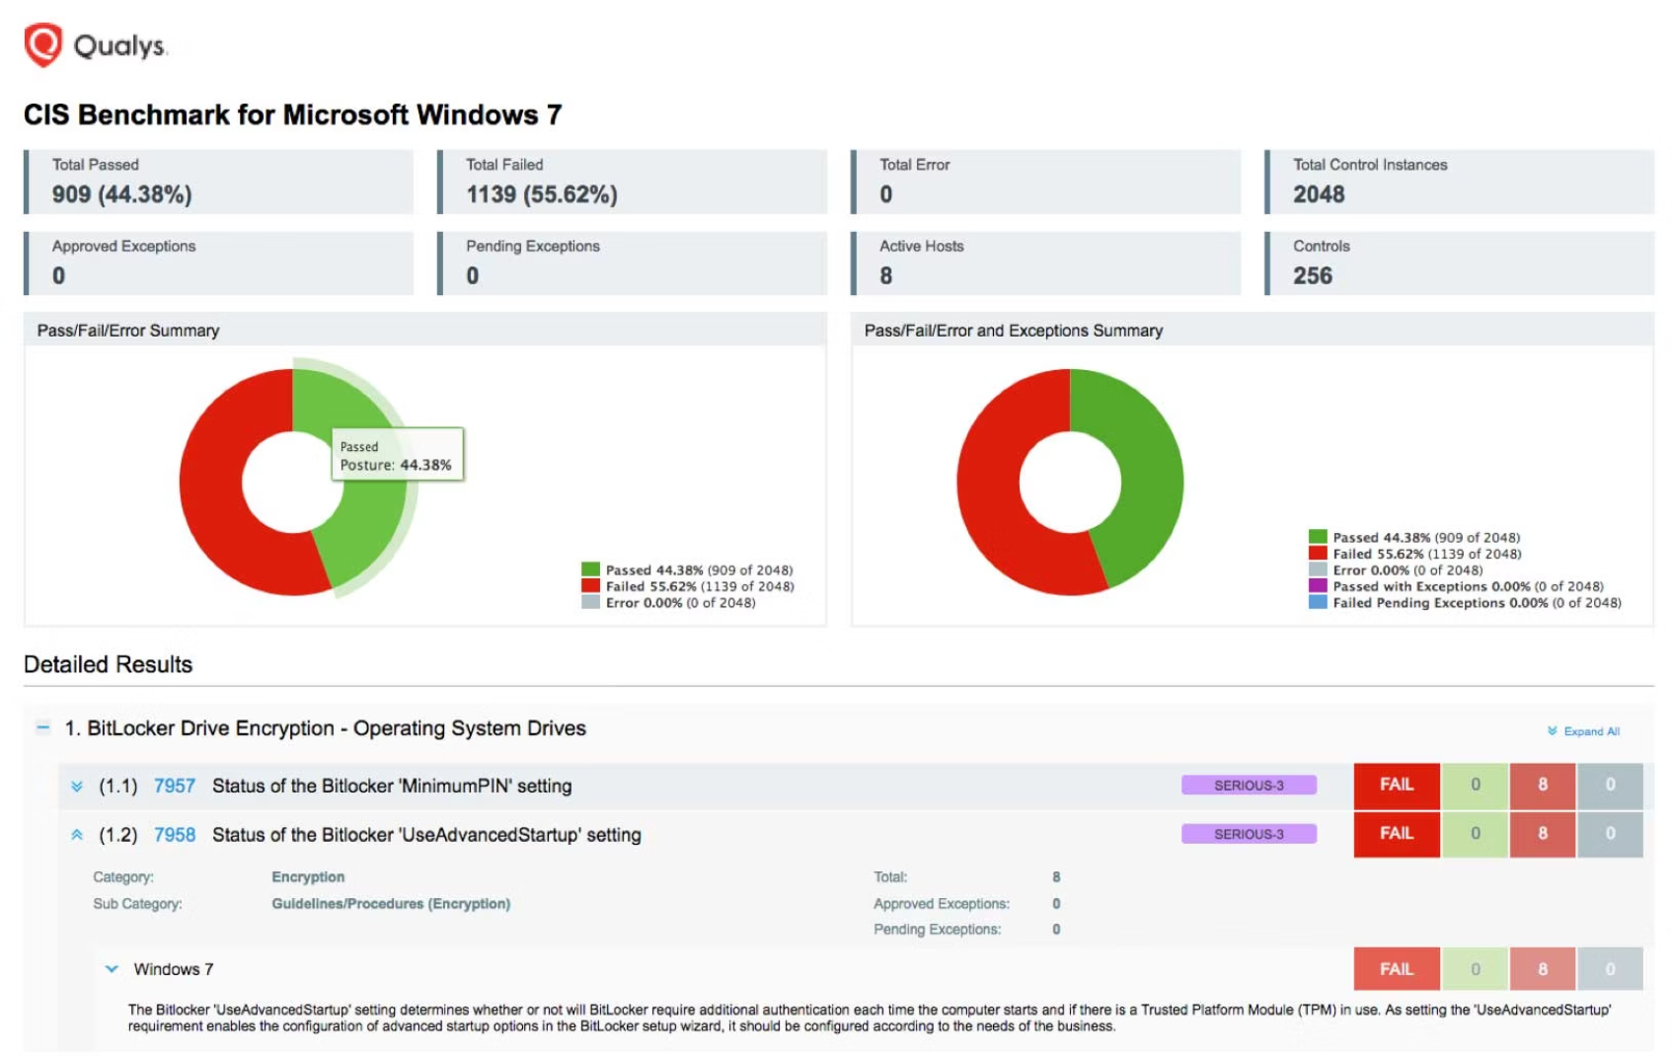
Interpreting Security Analysis Results
Understanding the visual indicators in the Security Configuration and Analysis snap-in is crucial for effective security auditing and remediation.
Green Check Mark ✓
The system configuration matches the security template baseline. No action required for this setting.
Red X ✗
Configuration mismatch detected. The current system setting differs from the template recommendation and requires review and potential remediation.
Question Mark ?
The setting was not defined in the security template or could not be analyzed. This may indicate a custom configuration or analysis limitation.
Analysis Best Practices: Always document discrepancies before applying configurations. Some red X indicators may be intentional based on your environment's specific requirements. Review each setting carefully in the context of your security policy and operational needs.

Slide 7
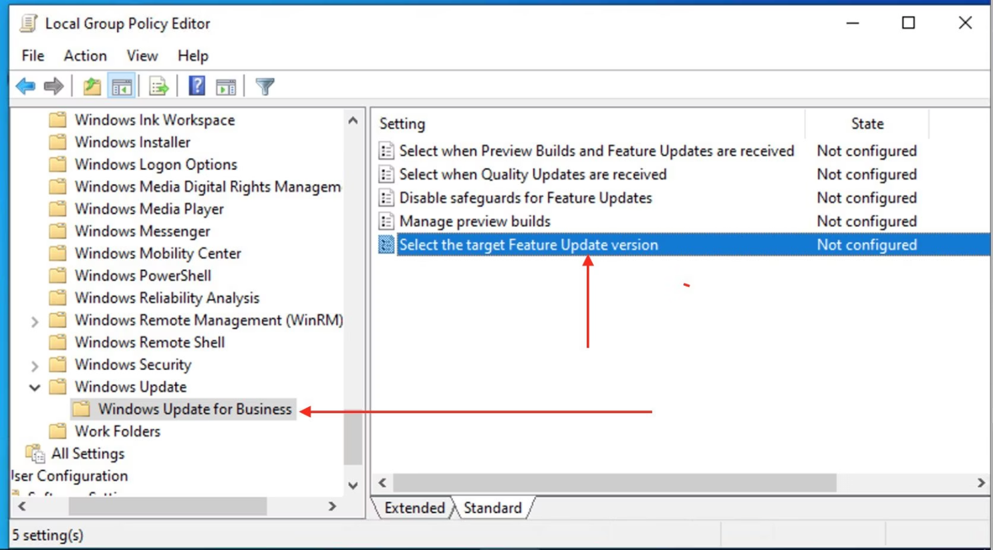

Understanding Local Group Policy Objects (GPOs)
Local Group Policy Objects are collections of security and configuration settings stored on individual computers that govern operating system behavior, user experience, and security controls. Unlike Domain GPOs, Local GPOs are confined to a single machine and do not require Active Directory infrastructure.
Local GPO Architecture and Hierarchy
Windows processes Local Group Policy in a specific order, with later policies overwriting earlier ones:
Local Computer Policy: The base policy applied to all users and the computer itself
Administrators and Non-Administrators Policy: Group-specific policies that apply based on administrative group membership
User-Specific Local Policy: Individual user policies that take final precedence
Accessing Local Group Policy Editor:
Press Win + R, type gpedit.msc, and press Enter
Important Note: The Local Group Policy Editor (gpedit.msc) is not available in Windows Home editions. You must use Windows Pro, Enterprise, or Education editions to access this tool.
Navigate through Computer Configuration for system-wide settings
Navigate through User Configuration for user-specific settings

Slide 8
Key Local Group Policy Categories
Security Settings
Administrative Templates
Scripts Configuration
Configure password policies, account lockout thresholds, user rights assignments, security options, and audit policies. This is the most critical category for security hardening.
Registry-based settings controlling Windows components, system features, Control Panel options, and network configurations. These policies modify HKLM and HKCU registry keys.
Define startup, shutdown, logon, and logoff scripts that automate administrative tasks. Scripts can be batch files, PowerShell scripts, or VBScript executables.
Practical Exercise - Setting a Password Policy via Local GPO:
1. Open gpedit.msc2. Navigate to: Computer Configuration > Windows Settings > Security Settings > Account Policies > Password Policy3. Double-click "Minimum password length"4. Set value to 12 characters, click OK5. Similarly configure "Password must meet complexity requirements" to Enabled6. Close editor - policy takes effect immediately (no reboot required for new logins)

Slide 9






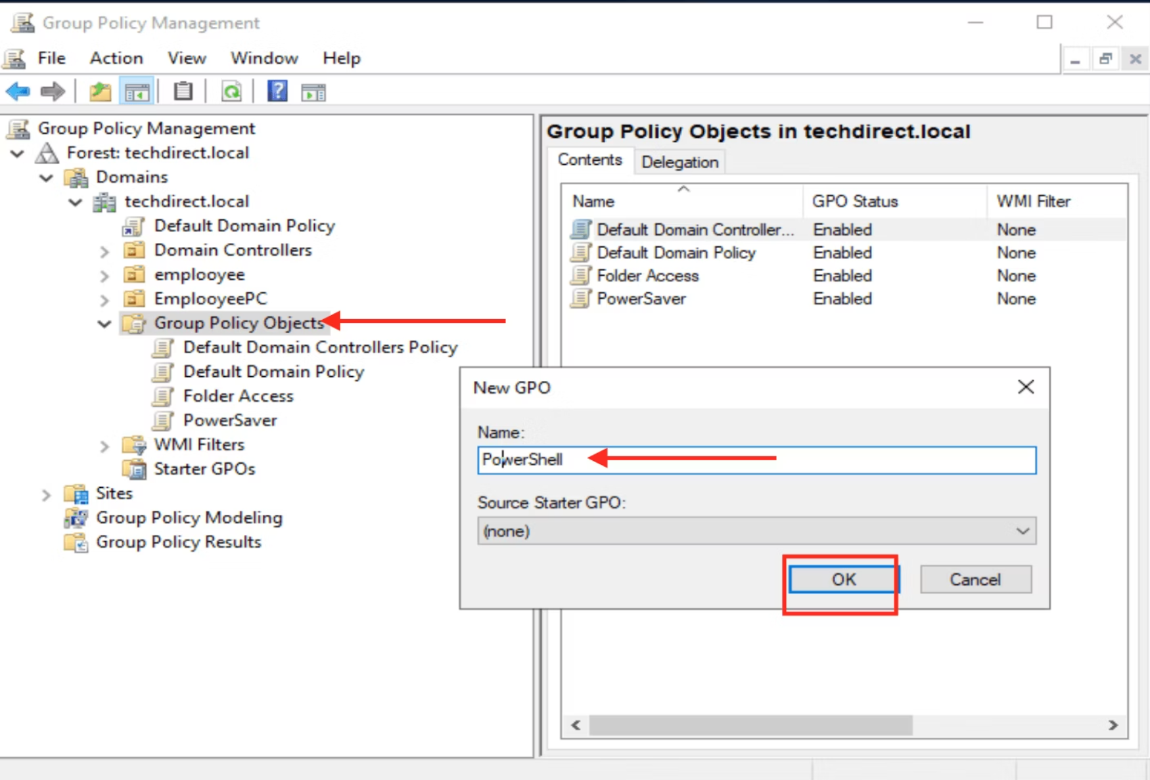
Domain Group Policy Objects: Enterprise-Scale Management
Domain Group Policy Objects are centrally managed policies stored in Active Directory that can be applied to users, computers, and organizational units across an entire enterprise. They provide consistent security enforcement and configuration management at scale.
Active Directory Integration
Scope and Inheritance
Security Filtering and WMI
Domain GPOs are stored in the SYSVOL share on domain controllers and replicated across all DCs. The Group Policy Template (GPT) contains files and the Group Policy Container (GPC) stores AD object properties.
GPOs can be linked to Sites, Domains, or Organizational Units. Child OUs inherit policies from parent containers unless explicitly blocked. Processing order: Local > Site > Domain > OU.
Control GPO application using security group membership (Security Filtering) or system attributes like OS version or IP address range (WMI Filtering) for granular targeting.
Opening Group Policy Management Console
Step-by-Step Process:
On a Domain Controller or RSAT-enabled workstation, press Win + R
Type gpmc.msc and press Enter
Expand Forest > Domains > YourDomain.com
Right-click Group Policy Objects and select New to create a GPO
Name your GPO descriptively (e.g., "Workstation Security Hardening")
Right-click the new GPO and select Edit to configure settings
Link the GPO to an OU by right-clicking the target OU and selecting Link an Existing GPO
GPO Processing Order: Understanding the LSDOU acronym is critical: Local, Site, Domain, Organizational Unit. Settings applied later override earlier ones unless "Enforced" or "Block Inheritance" is configured.

Slide 10
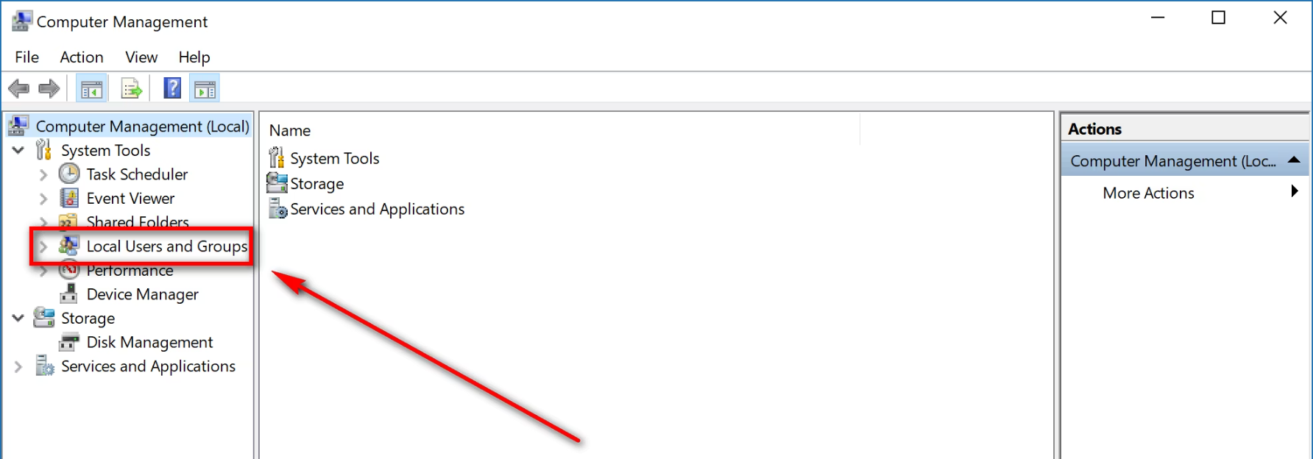
Managing Administrative Users and Privileges
Proper management of administrative accounts is fundamental to Windows security. The principle of least privilege dictates that users should only have the minimum permissions necessary to perform their job functions. Administrative access should be carefully controlled, monitored, and audited.
Standard User Accounts
Administrative Accounts
Built-in Administrator
Daily-use accounts with limited privileges. Cannot install software, modify system settings, or access other users' files without elevation.
Separate privileged accounts used only for administrative tasks. Should never be used for email, web browsing, or routine activities.
The most powerful account on a system. Should be renamed, given a complex password, and disabled when not needed for emergency recovery.
Practical Lab: Implementing Secure Administrative Practices
Task 1: Rename and Secure Built-in Administrator
1. Open gpedit.msc or gpmc.msc2. Navigate to: Computer Configuration > Windows Settings > Security Settings > Local Policies > Security Options3. Double-click "Accounts: Rename administrator account"4. Enter new name (e.g., "SA_Admin_2024")5. Set "Accounts: Administrator account status" to Disabled6. Apply and document the new account name securely
Task 2: Create Secondary Admin Account
1. Open Computer Management (compmgmt.msc)2. Navigate to Local Users and Groups > Users3. Right-click Users, select New User4. Username: admin_[yourname], Full name: [Your Name] Admin5. Set complex password (min 15 characters)6. Uncheck "User must change password at next logon"7. Check "Password never expires" (document in secure location)8. Click Create, then add to Administrators group
Security Best Practice: Implement a naming convention that doesn't obviously identify administrative accounts (avoid "admin", "administrator", "root"). Use account descriptions in Active Directory to document ownership while keeping usernames obscured.
Task 3: Verify Administrative Group Membership
PowerShell Command:Get-LocalGroupMember -Group "Administrators"This lists all members of the local Administrators group.Review regularly and remove unnecessary accounts.

Slide 11










AppLocker: Application Control Policies
AppLocker is a sophisticated application control technology that allows administrators to specify which applications, scripts, installers, and DLLs are permitted to run on Windows systems. By implementing a "whitelist" approach, organizations can dramatically reduce the risk of malware execution, unauthorized software installation, and insider threats.
Windows Installer Rules
Executable Rules
Govern .msi, .msp, and .mst files to control software installation and prevent unauthorized package deployment.
Control .exe and .com files. Most common rule type for preventing unauthorized application execution.
Script Rules
Manage .ps1, .bat, .cmd, .vbs, and .js files to prevent malicious script execution and PowerShell-based attacks.
Packaged Apps
Manage Windows Store apps and Universal Windows Platform applications through publisher-based rules.
DLL Rules
Control dynamic link libraries, though this requires more overhead. Use only in high-security environments due to performance impact.
AppLocker Rule Conditions
AppLocker provides three methods for identifying applications:
Publisher Rules: Based on digital signatures from trusted publishers. Most flexible and maintainable option that survives application updates.
Path Rules: Based on file location. Useful for custom applications but vulnerable to file moves or unauthorized copies to allowed paths.
File Hash Rules: Based on cryptographic hash of the file. Most secure but requires updates for every application version.

Slide 12
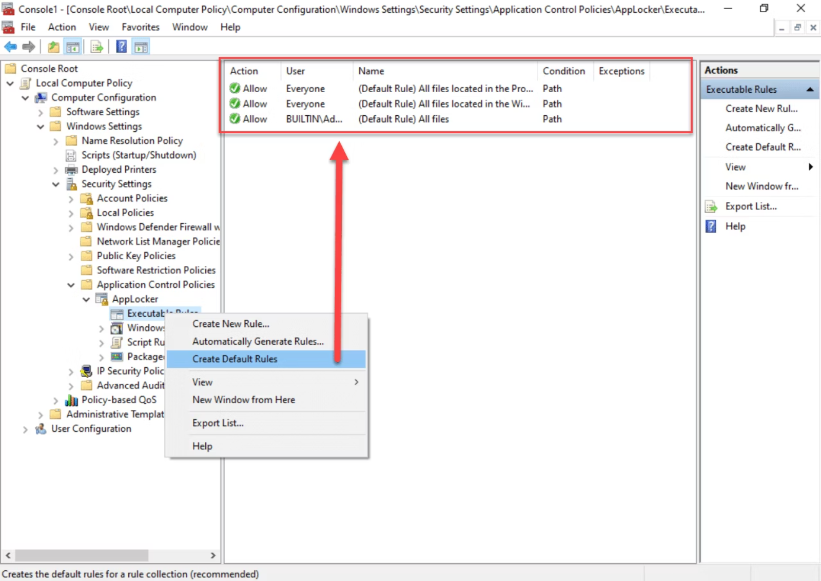
Implementing AppLocker: Hands-On Configuration
Creating AppLocker Rules - Step by Step
Part 1: Access AppLocker Configuration
1. Open gpedit.msc (Local) or gpmc.msc (Domain)2. Navigate to: Computer Configuration > Policies > Windows Settings > Security Settings > Application Control Policies > AppLocker3. Review "Configure rule enforcement" settings4. Set enforcement mode for each rule type
Part 2: Generate Default Rules
5. Right-click "Executable Rules" > "Create Default Rules"6. Review three default rules created: - Allow Administrators all files - Allow Everyone Windows files - Allow Everyone Program Files7. Repeat for Windows Installer Rules and Script Rules
Part 3: Create Custom Executable Rule
8. Right-click "Executable Rules" > "Create New Rule"9. Select "Before You Begin" > Next10. Choose "Permissions: Allow" and "User/Group: Everyone" > Next11. Select "Conditions: Publisher" > Next12. Click "Browse" and navigate to an application (e.g., C:\Program Files\Mozilla Firefox\firefox.exe)13. Adjust slider to desired specificity level (Publisher, Product, File version)14. Click Next, review rule, provide description > Create15. Test by attempting to run allowed/blocked applications with standard user account
Prerequisites
Before configuring AppLocker, ensure the Application Identity service is running:
1. Press Win + R, type services.msc2. Locate "Application Identity"3. Right-click > Properties4. Set Startup type to "Automatic"5. Click Start, then OK
Critical Warning: Always test AppLocker rules in Audit mode before switching to Enforce mode. Check Event Viewer (Application and Services Logs > Microsoft > Windows > AppLocker) to identify blocked applications that should be allowed.

Slide 13
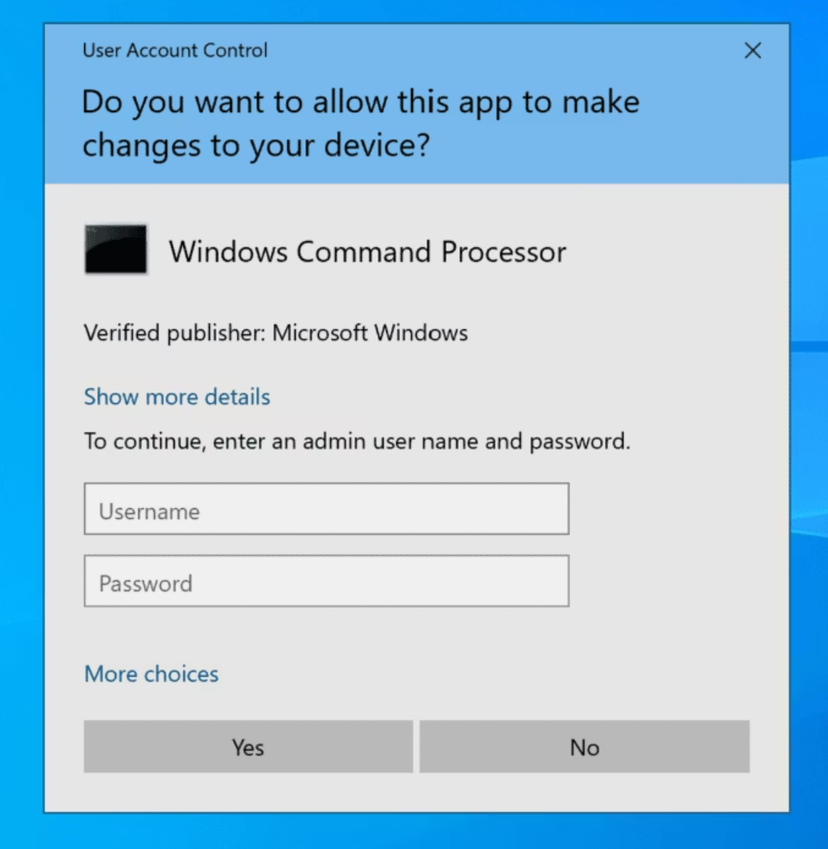
User Account Control (UAC): Elevation and Consent
User Account Control is a fundamental security feature that prevents unauthorized changes to the operating system by prompting for administrator approval when applications attempt to perform tasks requiring elevated privileges. UAC runs applications with standard user tokens by default, even when logged in with an administrator account, implementing the principle of least privilege at the process level.
Token Creation
1
When administrators log in, Windows creates two tokens: a full administrator token and a filtered standard user token.
2
Process Launch
Applications launch with the filtered token by default, restricting privileges even for administrator accounts.
Elevation Request
3
When an application requires elevated privileges, it requests elevation through a manifest or runtime API call.
4
Secure Desktop
The screen dims and a consent prompt appears on the secure desktop, which other processes cannot interfere with.
User Decision
5
The administrator provides consent or credentials, and the application receives the full administrator token if approved.
UAC Prompt Types
Red Shield - Blocked
Application is blocked by administrator and cannot run even with elevation.
Blue/Yellow Shield - UAC Prompt
Standard elevation request. Blue for Windows components, yellow for third-party applications.
Gray Shield - Standard User
Administrator credentials required. Standard users must provide admin username and password.
Security Recommendation: Always read UAC prompts carefully. Verify the program name, publisher, and file origin before approving elevation. Malware often triggers UAC prompts hoping users will blindly click "Yes."

Slide 14
Configuring User Account Control Policies
UAC behavior can be fine-tuned through Group Policy to balance security with usability based on your organization's risk tolerance and operational requirements. Understanding each setting is crucial for maintaining security without frustrating users.
Hands-On Lab: Configuring UAC Settings
Access UAC Policy Settings:1. Open gpedit.msc or gpmc.msc2. Navigate to: Computer Configuration > Policies > Windows Settings > Security Settings > Local Policies > Security Options3. Locate policies beginning with "User Account Control:"
Admin Approval Mode
Elevation Behavior
Policy: "User Account Control: Run all administrators in Admin Approval Mode"
Policy: "User Account Control: Behavior of the elevation prompt for administrators"
Recommended: Enabled. Disabling this setting eliminates UAC protection entirely, even for standard users.
Recommended: "Prompt for consent on the secure desktop" for maximum security. Never use "Elevate without prompting."
Secure Desktop
Application Detection
Policy: "User Account Control: Switch to secure desktop when prompting for elevation"
Policy: "User Account Control: Detect application installations and prompt for elevation"
Recommended: Enabled. This prevents malware from simulating or automating UAC prompts.
Recommended: Enabled in desktop environments to prevent unauthorized software installation.
Testing UAC Configuration
Quick Test Procedure:1. Log in as standard user2. Right-click Command Prompt3. Select "Run as administrator"4. Observe UAC prompt behavior5. Check if credentials are required6. Verify secure desktop activation
PowerShell UAC Status Check:Get-ItemProperty -Path ` "HKLM:\SOFTWARE\Microsoft\Windows\` CurrentVersion\Policies\System" | ` Select-Object EnableLUA, ` ConsentPromptBehaviorAdminEnableLUA: 1 = UAC enabledConsentPromptBehaviorAdmin: 0 = Elevate without prompting 1 = Prompt for credentials 2 = Prompt for consent 5 = Prompt for consent (secure desktop)

Slide 15
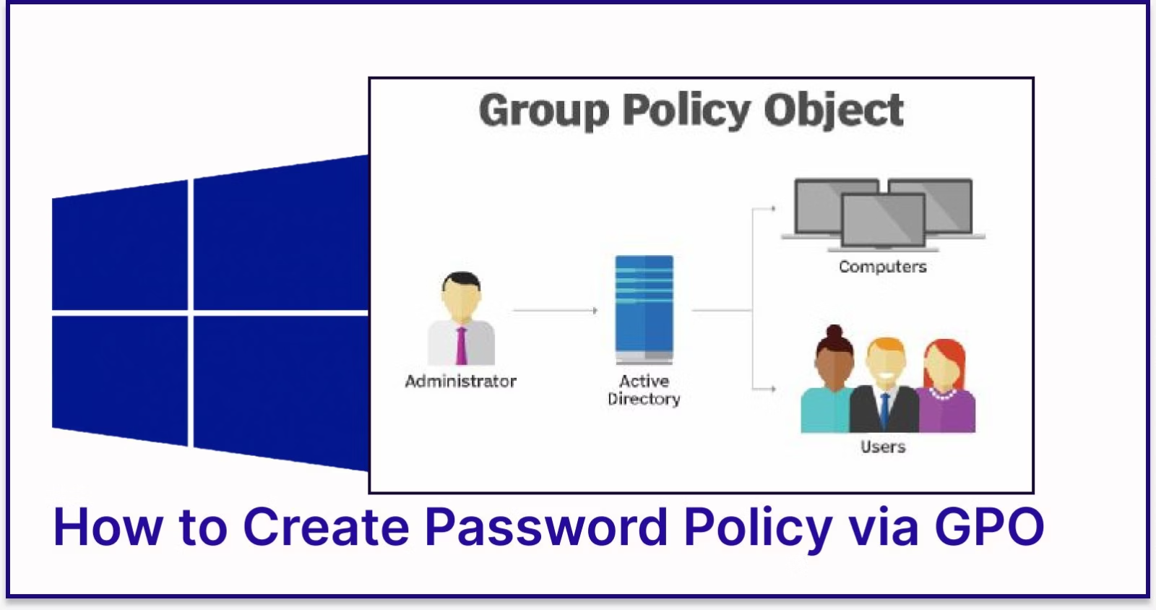

Password Policy Configuration and Best Practices
Password policies are the first line of defense against unauthorized access. A well-configured password policy balances security requirements with user productivity, reducing the risk of compromised credentials while maintaining system usability.
Recommended Password Policy Settings
1
Minimum Password Length
Recommended: 12-14 characters minimum. Research shows length is more important than complexity for resisting brute-force attacks.
2
Password Complexity Requirements
Recommended: Enabled. Requires three of four character types: uppercase, lowercase, digits, special characters. Prevents common dictionary words.
3
Maximum Password Age
Recommended: 90-180 days. NIST guidelines suggest longer intervals if multi-factor authentication is implemented. Balance security with password reuse risks.
4
Implementation Steps
Minimum Password Age
Local Computer:1. gpedit.msc2. Computer Configuration > Windows Settings > Security Settings > Account Policies > Password Policy3. Configure each setting4. Close editor (applies immediately)Domain Environment:1. gpmc.msc2. Right-click domain or OU > Create and Link GPO3. Edit GPO > Same path as above4. Wait for replication (or force: gpupdate /force)
Recommended: 1-2 days. Prevents users from rapidly cycling through password history to return to a preferred password.
5
Password History
Recommended: 24 passwords remembered. Prevents password reuse over a 2-year period with 90-day rotation policy.
6
Store Passwords Using Reversible Encryption
Recommended: Disabled (unless required for specific legacy protocols). Reversible encryption provides the same security as plaintext storage.
Important: Password policies linked at the domain level apply to all domain users. Fine-grained password policies (PSOs) allow different password requirements for specific groups via AD Administrative Center.

Slide 16
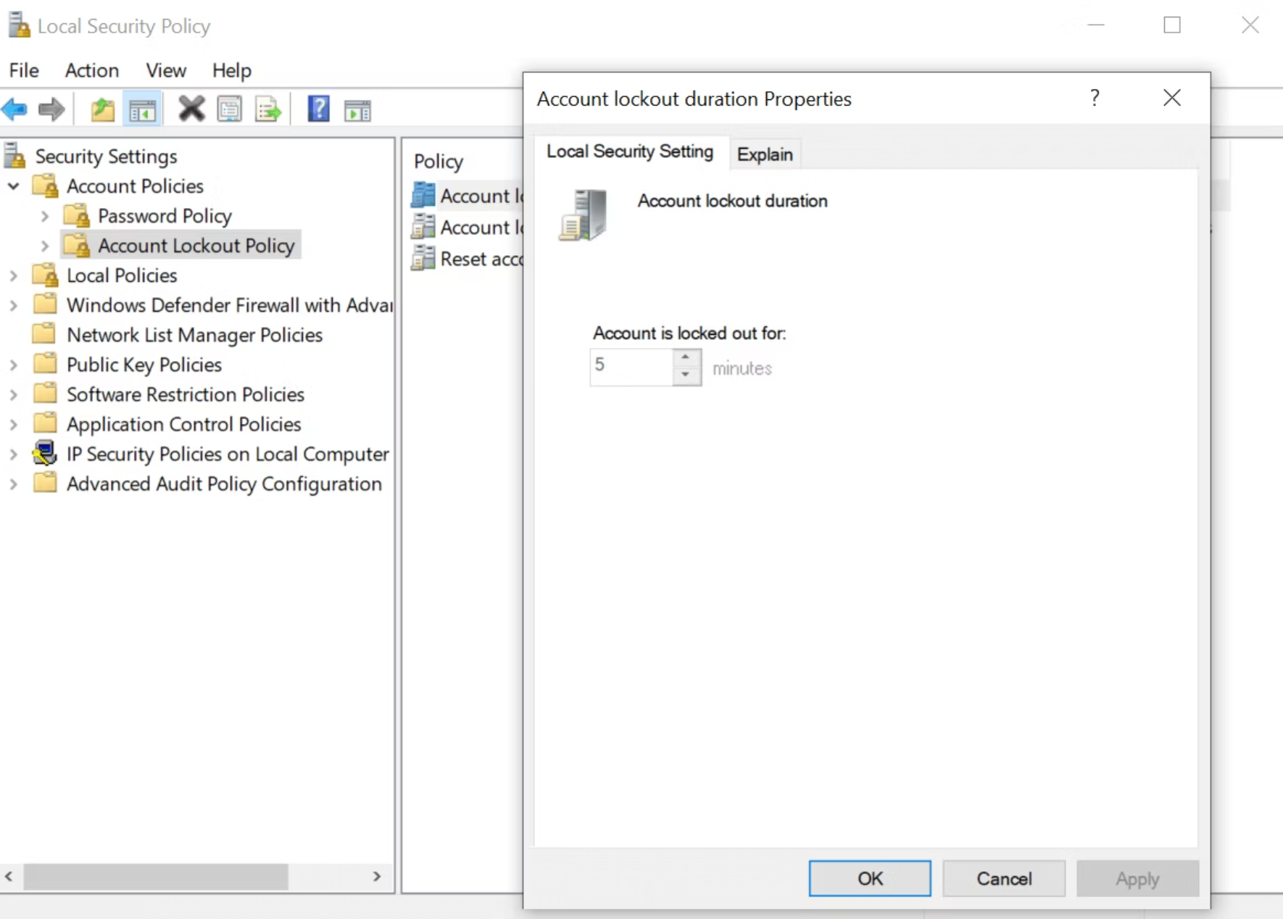
Account Lockout Policy: Protecting Against Brute Force
Account lockout policies automatically disable user accounts after a specified number of failed login attempts, protecting against password guessing attacks, brute force attempts, and dictionary attacks. Proper configuration is essential to balance security with operational concerns like support desk workload.
Account Lockout Threshold
Account Lockout Duration
Reset Account Lockout Counter After
Recommended Value: 5-10 invalid logon attempts. Setting too low causes legitimate lockouts; too high reduces protection. Zero disables lockout entirely.
Recommended Value: 15-30 minutes. This is how long an account remains locked. Setting to 0 requires administrator intervention to unlock (high support burden).
Recommended Value: 15-30 minutes (should be less than or equal to lockout duration). Defines when the failed attempt counter resets.
Configuration Path: Computer Configuration > Windows Settings > Security Settings > Account Policies > Account Lockout Policy
Operational Impact: Shorter durations reduce help desk tickets but may allow automated attacks to resume sooner. Balance based on your security monitoring capabilities.
Attack Scenario Prevention: Setting this appropriately prevents slow-burn attacks that space failed attempts just beyond the reset window.
Security Consideration: Consider implementing progressive delays instead of hard lockouts for high-profile accounts to prevent denial-of-service attacks against administrators.
Practical Exercise: Configure Lockout Policy
Step-by-Step Configuration:1. Open gpedit.msc or gpmc.msc2. Navigate to Account Lockout Policy3. Set "Account lockout threshold" to 54. Windows auto-suggests values for other two settings (15 minutes)5. Accept or customize based on policy6. Click OK to apply7. Test with incorrect passwords8. Monitor Security Event Log (Event ID 4740)
Monitoring Lockouts: Use Event Viewer to track lockout events. Navigate to Windows Logs > Security and filter for Event ID 4740 (account locked out) and 4767 (account unlocked). This helps identify potential attacks or user issues.

Slide 17

Critical Security Options and Administrative Templates
Security Options provide granular control over Windows security behavior. These settings modify system-level security mechanisms, authentication protocols, and user session management. Administrative Templates complement these with registry-based controls for applications and Windows components.
Essential Security Options
Interactive Logon: Message Text and Title
Network Security: LAN Manager Authentication Level
Display legal notice before user login. Required for legal prosecution of unauthorized access in many jurisdictions.
Controls NTLM authentication protocols. Set to "Send NTLMv2 response only. Refuse LM & NTLM" to prevent legacy protocol vulnerabilities.
Path: Security Options > Interactive logon: Message text/title for users attempting to log on
Security Impact: Blocks pass-the-hash attacks and credential replay exploits.
Network Access: Do Not Allow Anonymous Enumeration
Shutdown: Allow System to be Shut Down Without Logon
Prevents anonymous users from enumerating account names and shares. Critical for preventing reconnaissance attacks.
Disabled on servers to prevent physical access attacks. Enabled on workstations for operational convenience.
Recommended: Enabled for both SAM accounts and shares.
Internet Explorer Security (Legacy) via Administrative Templates
While Microsoft Edge is the current browser, many organizations still manage Internet Explorer through Group Policy for legacy application compatibility:
Configuration Path:Computer/User Configuration > Administrative Templates > Windows Components > Internet ExplorerKey Settings:- Security Zones: Use only machine settings- Prevent ignoring certificate errors- Turn on Enhanced Protected Mode- Disable changing Automatic Configuration settings- Turn off Crash Detection
Modern Approach: Organizations should transition to Microsoft Edge with Enterprise Mode for legacy site compatibility. Configure Edge policies under Administrative Templates > Microsoft Edge.

Slide 18
Using Secedit: Command-Line Security Configuration
Secedit.exe is a powerful command-line utility for analyzing, configuring, and exporting security policy settings. It provides scriptable security management capabilities essential for automation, auditing, and disaster recovery. System administrators use Secedit to enforce consistent security baselines across multiple systems without GUI interaction.
Secedit Command Syntax and Common Operations
01
02
Export Current Security Configuration
Analyze System Against Template
Extract the current security policy to a human-readable .inf file for documentation or baseline comparison.
Compare current configuration against a security template database to identify deviations and vulnerabilities.
secedit /export /cfg C:\SecurityBaseline.inf /log C:\secedit.log
secedit /analyze /db C:\Security.sdb /cfg C:\hisecws.inf /log C:\analysis.log
This creates a complete snapshot of all security settings including password policy, user rights, registry permissions, and audit settings.
Review the analysis.log file for discrepancies. Create the database on first run using /db parameter.
03
04
Apply Security Template Configuration
Generate Security Rollback Template
Deploy security settings from a template file to the local system, enforcing organizational security baseline.
Create a restoration point by exporting current settings before applying new security configurations.
secedit /configure /db C:\Security.sdb /cfg C:\securedc.inf /log C:\configure.log
secedit /generaterollback /cfg C:\NewPolicy.inf /rbk C:\Rollback.inf /log C:\rollback.log
Warning: Always test in lab environment first. Incorrect configurations can prevent system boot or lock out administrators.
Apply the rollback template if new configuration causes issues: secedit /configure /db C:\Security.sdb /cfg C:\Rollback.inf
Practical Secedit Scenarios
Scenario 1: Automated Security Audit Script
Scenario 2: Mass Deployment with PowerShell
@echo offREM Daily security audit automationset LOGPATH=C:\SecurityAudits\%date:~-4,4%%date:~-10,2%%date:~-7,2%mkdir %LOGPATH%secedit /export /cfg %LOGPATH%\current.inf /log %LOGPATH%\export.logsecedit /analyze /db C:\baseline.sdb /cfg C:\templates\secure_baseline.inf /log %LOGPATH%\analysis.logecho Audit complete. Check %LOGPATH% for results.
$computers = Get-ADComputer -Filter * -SearchBase "OU=Workstations,DC=domain,DC=com"foreach ($comp in $computers) { Invoke-Command -ComputerName $comp.Name -ScriptBlock { secedit /configure /db C:\Windows\security\local.sdb /cfg \\fileserver\templates\ws_security.inf /overwrite /quiet }}Write-Host "Security baseline deployed to all workstations"

Slide 19


Securing Windows Networks: Defense in Depth Strategy
Network security in Windows environments requires a multi-layered approach combining firewalls, network segmentation, protocol hardening, and monitoring. A comprehensive defense-in-depth strategy assumes that no single security control is perfect and implements overlapping protections at network, host, and application layers.
1
Network Perimeter
2
Network Segmentation & VLANs
3
Windows Firewall & IPsec
4
SMB & RPC Hardening
5
Endpoint Security & EDR
Windows Firewall with Advanced Security - Configuration Lab
Accessing Windows Firewall Advanced Settings:
Create Inbound Rule - Block Unauthorized Services:
Method 1: GUI1. Press Win + R2. Type: wf.msc3. Press EnterMethod 2: Command Linenetsh advfirewall show allprofilesMethod 3: PowerShellGet-NetFirewallProfile
1. Open wf.msc2. Select "Inbound Rules"3. Click "New Rule" in Actions pane4. Rule Type: Port > Next5. Protocol: TCP, Specific ports: 135,139,4456. Action: Block the connection7. Profile: All (Domain, Private, Public)8. Name: "Block SMB and RPC from Internet"9. Description: Prevents external access10. Finish > Verify rule appears enabled
PowerShell Alternative:
New-NetFirewallRule -DisplayName "Block SMB/RPC" -Direction Inbound -Protocol TCP -LocalPort 135,139,445 -Action Block -Profile Any
Key Network Security Group Policy Settings
Network Security: Minimum Session Security
Microsoft Network Server: Digitally Sign Communications
Network Access: Named Pipes Accessible Anonymously
Require NTLMv2 session security and 128-bit encryption for NTLM authentication. Prevents downgrade attacks.
Enable SMB signing to prevent man-in-the-middle attacks. Required setting for domain controllers.
Remove all entries unless specifically required. Prevents anonymous reconnaissance and null session attacks.

Slide 20




Summary: Windows Security Policy Implementation Checklist
This comprehensive guide has covered the essential tools and techniques for implementing enterprise-grade Windows security. Below is your actionable checklist for securing Windows systems from workstations to domain controllers.
Security Templates & Analysis
Group Policy Architecture
Create custom security template baselines for each computer role
Implement GPO naming convention (Purpose-Location-Date)
Schedule regular Security Configuration and Analysis scans
Use security filtering and WMI for targeted policy application
Document all deviations from baseline with business justification
Document GPO links and inheritance with network diagrams
Use Secedit for automated deployment and auditing
Configure password, lockout, and audit policies domain-wide
Test policies with GPResult and GPUpdate commands
Administrative Controls
Network Security Hardening
Rename and disable built-in Administrator account
Enable Windows Firewall on all profiles with documented exceptions
Enforce separate admin accounts for privileged operations
Require SMB signing and disable SMBv1 protocol
Configure UAC with "Prompt for consent on secure desktop"
Configure LAN Manager authentication to NTLMv2 only
Implement AppLocker for application control with audit mode testing
Block anonymous enumeration and null sessions
Document all administrative access and maintain audit logs
Implement IPsec for sensitive network segments
Next Steps: Continuous Security Improvement
Security is not a one-time implementation but an ongoing process. Establish regular review cycles, maintain documentation, monitor security events, and stay informed about emerging threats and vulnerabilities. Test your configurations regularly through security assessments and penetration testing. Most importantly, train your users - the human element remains both the strongest and weakest link in any security strategy.
"Security is a process, not a product." – Bruce Schneier
Apply the principles learned in this course systematically, document your implementations thoroughly, and continuously validate that your security controls are functioning as intended. Your organization's security posture depends on the rigor and consistency of your Windows security policy implementation.

